Slide 1





Astro Brewing Co. Launch Strategy
11/
Wanfeng Deng
Tianrun Gu
Maximilian Johnson
Jingwei Li
Presented by Team F:
Wanfeng Deng, Tianrun Gu, Maximilian Johnson, Jingwei Li
Project: Astro Brewing Co. Case 1
Section: GBA 424 8:30 – 10:00
Date: 11/2/2020

Slide 2
Requested Studies
Study C: Project the change of customers acceptance level from 1998 to 2003 in marketing areas (CA, TX, NM, AZ)
Study D: Predict number of liquor sale operations growth within five years in these marketing area.
Study F: Knowledge of operations’ past experience from 152 similar wholesalers.
Study H: Attribution advantage, retailer support, and competitors

Slide 3
Sensitivity Analysis
Key Uncertainties
Consumer interest
Retailer interest
Scenario
Different profit outcomes with different interest levels
Probability
Customer - Estimated based on operations in the other states
Retailer – retailer questionnaire from Study H
Calculate Outcomes
Assigned $ values based on the due diligence and study F
Evaluate Decision
Calculate Expected Value

Slide 4
Key Findings
Astro projected to have 20% market share in its first year of operation
88.7% potential retailers showed they will certainly sell Astro.
Compared to other beers, retailers are very excited to carry Astro
Number of retailers expected to grow in each of the first 5 years
Positive expected value of opening a distributorship in South Western Oregon
Break even in the sixth year
Average ROI over each of the first 6 years is 21%
Source: Various publications; Oregon Department of Revenue, Liquor Division; Robert Morris Associates annual statement studies; Lawson and Associates

Slide 5
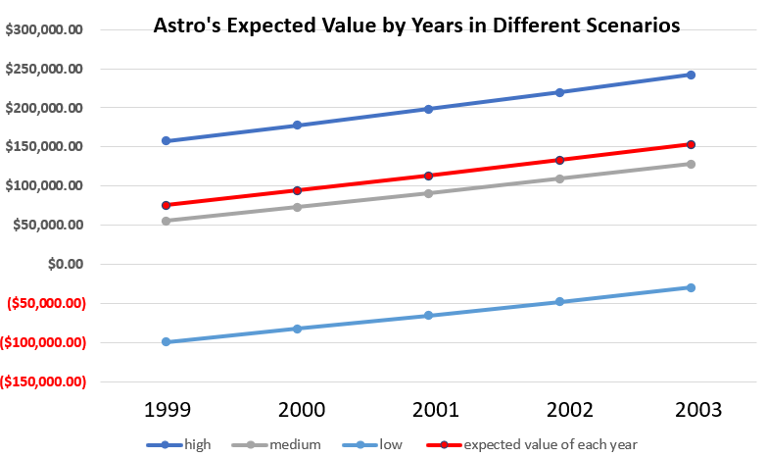
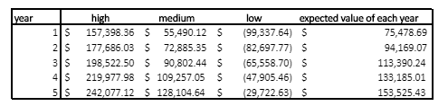
Expected value of this project is positive and will be $153,525 in 2003
Astro’s Project is Profitable
3% annul growth rate for sales
Probabilities of different scenarios:
High Consumer Interest: 50%
Medium Consumer interest: 30%
Low Consumer Interest: 20%
source: Lawson & Associates’ study C & F
Notes:
*add key findings and ideas under graph
*Title

Slide 6
Astro Brewing Co. Should Launch the Project
Considerable projected market share growth in Southwestern Oregon (Study C)
More than 10% annual growth rate for the first three years (Appendix B )
Positive expected value for the whole project with assumption of 50% consumers will have high interest, 30% consumers will have medium interest, and 20% consumers will have low interest to Astro’s. (Study H)
Project’s ROI = 21% (Appendix C)
source: Lawson & Associates’ study C & F
Notes:
*add key findings and ideas under graph
*Title

Slide 7
Q&A
Wanfeng Deng
Tianrun Gu
Maximilian Johnson
Jingwei Li

Slide 8
Appendix A-1
Profit is calculated based on Due Diligence and Study F, we used similar approach to calculate year 1’s sales, COGS, and variable cost
Study F:
% profit before Tax based on Total Assets: 10.9%
Profit before tax ratio: 2.6%
Due Diligence:
Total investment: $1,600,000
Profit = $1,600,000 * 10.9% = $174,400
Sales = $174,400 / 2.6% = $6,707,692.31

Slide 9
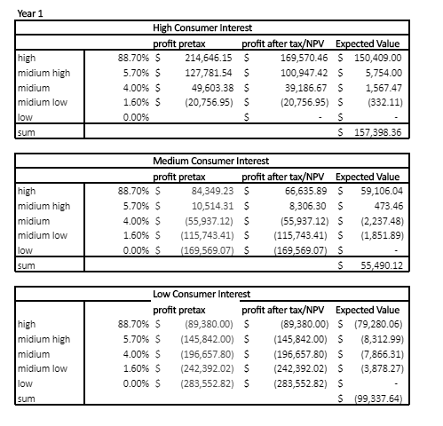
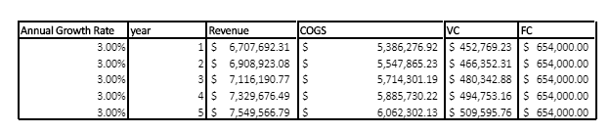
Appendix A-2
Sensitivity Analysis based on different scenarios; it was calculated based on the following tables.
Assumptions:
Constant 3% annual growth rate for sales
Sales, COGS, variable cost will change because of the 3% growth rate, while fix cost stay constant
Whenever retailer's interest goes down one level, sales, COGS, and VC will have 10% loss
Tax rate is 21%
NPV = probability * profit * ratio of consumer interest level

Slide 10
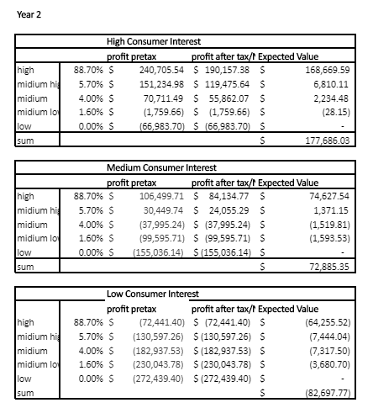
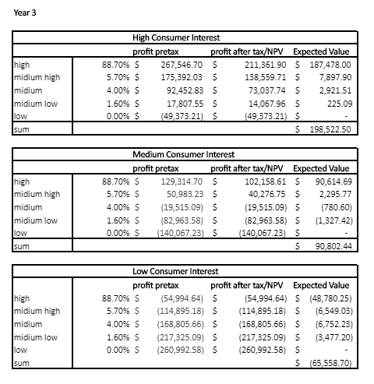
Appendix A-3

Slide 11
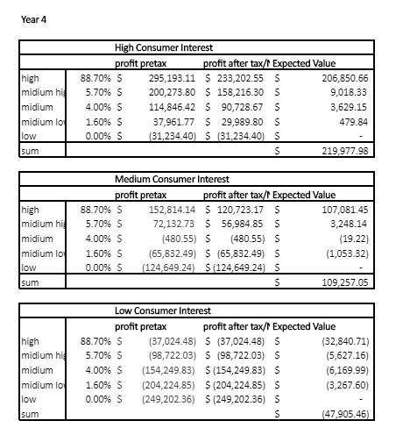
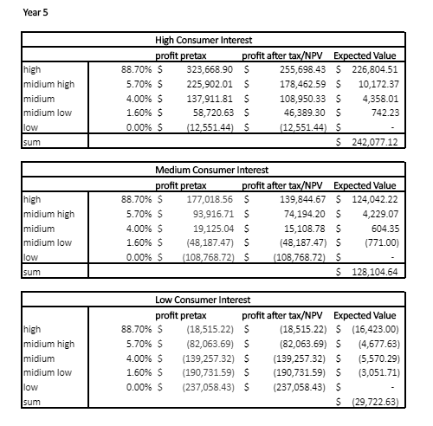
Appendix A-4

Slide 12
Appendix B
Year | Market Share % | Annual Growth Rate
1998 | 22.00% | NA
1999 | 25.00% | 13.64%
2000 | 30.00% | 20.00%
2001 | 33.00% | 10.00%
2002 | 35.00% | 6.06%
2003 | 36.00% | 2.86%

Slide 13
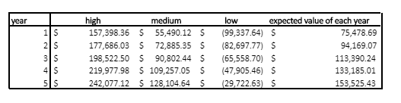
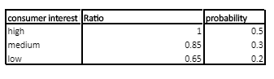
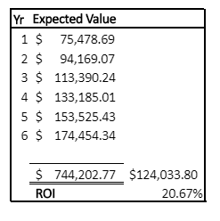
Appendix C
First year’s projected profit is based on Appendix A
To project the expected value of each year, we assumed that the probability consumer will have high, medium, and low interest would be, 50%, 30%, and 20% respectively.
Project ROI

Slide 14
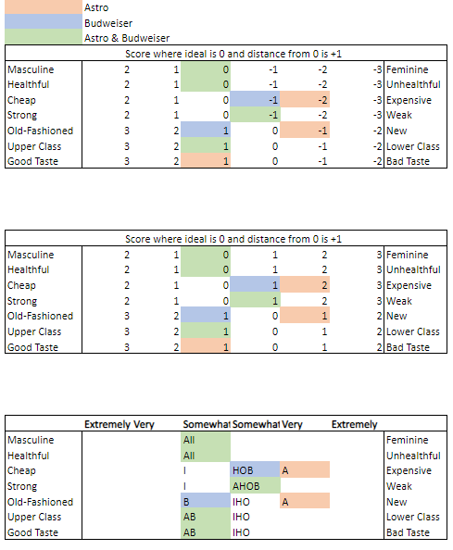
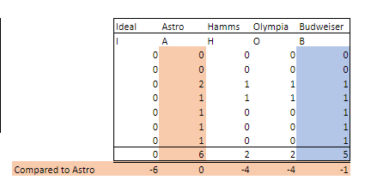
Appendix D
Based on study H, we examined the data and found that Budweiser is similar to Astro in almost all aspects.

